Slide 1
CST8250
Entity Relationship Diagrams (ER Diagrams)
Week 2

Slide 2
Objectives
Define terms related to entity relationship modeling, including entity, entity instance, attribute, relationship and cardinality, and primary key (covered in week 1 slides).
Describe the entity modeling process.
Review relationships and cardinality.
Discuss how to draw an entity relationship diagram.
Describe how to recognize entities, attributes, relationships, and cardinalities.

Slide 3
Database Model
A database can be modeled as:
a collection of entities,
relationship among entities.
Database systems are often modeled using an Entity Relationship (ER) diagram as the "blueprint" from which the actual data is stored — the output of the design phase.

Slide 4
Entity Relationship Diagram (ERD)
ER model allows us to sketch database designs
ERD is a graphical tool for modeling data.
ERD is widely used in database design
ERD is a graphical representation of the logical structure of a database
ERD is a model that identifies the concepts or entities that exist in a system and the relationships between those entities

Slide 5
Purposes of ERD
An ERD serves several purposes
The database analyst/designer gains a better understanding of the information to be contained in the database through the process of constructing the ERD.
The ERD serves as a documentation tool.
Finally, the ERD is used to communicate the logical structure of the database to users. In particular, the ERD effectively communicates the logic of the database to users.

Slide 6
Components of an ERD
An ERD typically consists of four different graphical components:
1. Entity
2. Relationship
3. Cardinality
4. Attribute

Slide 7
Classification of Relationship
Optional Relationship
An Employee may or may not be assigned to a Department
A Patient may or may not be assigned to a Room
Mandatory Relationship
Every Course must be taught by at least one Teacher
Every Mother has at least one Child

Slide 8

Cardinality Constraints
Express the number of entities to which another entity can be associated via a relationship set.
Cardinality Constraints - the number of instances of one entity that can or must be associated with each instance of another entity.
Minimum Cardinality
If zero, then optional
If one or more, then mandatory
Maximum Cardinality
The maximum number

Slide 9
Cardinality Constraints (cont.)
For a binary relationship set the mapping cardinality must be one of the following types:
One to one
A Manager Heads one Department and vice versa
One to many ( or many to one)
An Employee Works in one Department or one Department has many Employees
Many to many
A Teacher Teaches many Students and a Student is taught by many Teachers

Slide 10
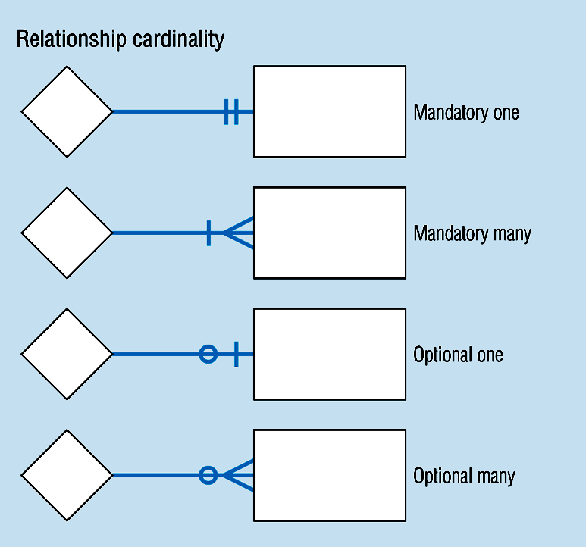
Cardinality Constraints (cont.)

Slide 11
Cardinality Constraints Example
In our model, we wish to indicate that each school may enroll many students, or may not enroll any students at all.
We also wish to indicate that each student attends exactly one school. The following diagram on the next slide indicates this optionality and cardinality.

Slide 12
Cardinality Constraints Example (cont.)

Slide 13
General Steps to create an ERD
Identify the entity
Identify the entity's attributes
Identify the primary keys
Identify the relationship between entities
Identify the cardinality constraint
Draw the ERD
Check the ERD

Slide 14
Steps in building an ERD

Slide 15
In Depth Steps to Develop an ERD
With practice, you may find it simpler to follow the steps outlined in the previous slides
We will follow this detailed process in the next example:
1. Identify Entities
2. Find Relationships
3. Draw Rough ERD
4. Fill in Cardinality
5. Define Primary Keys
6. Draw Key-Based ERD
7. Identify Attributes
8. Map Attributes
9. Draw fully attributed ERD
10. Check Results

Slide 16
A Simple Example
A company has several departments. Each department has a supervisor and at least one employee. Employees must be assigned to at least one, but possibly more departments. At least one employee is assigned to a project, but an employee may be on vacation and not assigned to any projects. The important data fields are the names of the departments, projects, supervisors and employees, as well as the supervisor and employee number and a unique project number.

Slide 17
Step 1: Identify entities
One approach to this is to work through the information and highlight those words which you think correspond to entities.
A company has several departments. Each department has a supervisor and at least one employee. Employees must be assigned to at least one, but possibly more departments. At least one employee is assigned to a project, but an employee may be on vacation and not assigned to any projects. The important data fields are the names of the departments, projects, supervisors and employees, as well as the supervisor and employee number and a unique project number.
A true entity should have more than one instance

Slide 18
Step 2: Find Relationships
Aim is to identify the associations, the connections between pairs of entities.
A simple approach to do this is using a relationship matrix (table) that has rows and columns for each of the identified entities.

Slide 19
Step 2: Find Relationships (cont.)
Go through each cell and decide whether or not there is an association. For example, the first cell on the second row is used to indicate if there is a relationship between the entity "Employee" and the entity "Department".

Slide 20
Step 2: Find Relationships (cont.)
Go through each cell and decide whether or not there is an association. For example, the first cell on the second row is used to indicate if there is a relationship between the entity "Employee" and the entity "Department".

Slide 21
Step 2: Identified Relationships
Names placed in the cells are meant to capture/describe the
relationships.
A Department is assigned an employee
A Department is run by a supervisor
An employee belongs to a department
An employee works on a project
A supervisor runs a department
A project uses an employee

Slide 22
Step 3: Draw Rough ERD
Draw a diagram and:
Place all the entities in rectangles
Use diamonds and lines to represent the relationships between entities.
General Examples

Slide 23


Step 3: Drawing Rough ERD (cont.)

Slide 24
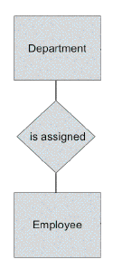
Step 3: Drawing Rough ERD (cont.)

Slide 25
Step 3: Drawing Rough ERD (cont.)

Slide 26
Step 4: Fill in Cardinality
Supervisor
Each department has one supervisor.
Department
Each supervisor has one department.
Each employee can belong to one or more departments
Employee
Each department must have one or more employees
Each project must have one or more employees
Project
Each employee can have 0 or more projects.

Slide 27
Step 4: Fill in Cardinality (cont.)
The cardinality of a relationship can only have the
following values
One and only one
One or many
Zero or many
Zero or one

Slide 28
Step 4: Cardinality Notation

Slide 29
Step 4: Cardinality Examples

Slide 30
Step 4: ERD with cardinality

Slide 31
Step 4: Examples

Slide 32
Step 5, 6: Rough ERD Plus Primary Keys

Slide 33
Step 7: Identify Attributes
In this step we try to identify and name all the attributes essential to the system we are studying without trying to match them to particular entities.
The best way to do this is to study the forms, files and reports currently kept by the users of the system and circle each data item on the paper copy.
Cross out those which will not be transferred to the new system, extraneous items such as signatures, and constant information which is the same for all instances of the form (e.g. your company name and address). The remaining circled items should represent the attributes you need. You should always verify these with your system users. (Sometimes forms or reports are out of date.)
The only attributes indicated are the names of the departments, projects, supervisors and employees, as well as the supervisor and employee NUMBER and a unique project number.

Slide 34
Step 8: Map Attributes
For each attribute we need to match it with exactly one entity. Often it seems like an attribute should go with more than one entity (e.g. Name). In this case you need to add a modifier to the attribute name to make it unique (e.g. Customer Name, Employee Name, etc.) or determine which entity an attribute "best' describes.
If you have attributes left over without corresponding entities, you may have missed an entity and its corresponding relationships. Identify these missed entities and add them to the relationship matrix now.

Slide 35
Step 8: Map Attributes (cont.)

Slide 36
Step 9: Draw Fully Attributed ERD

Slide 37
Step 10: Check ERD Results
Look at your diagram from the point of view of a system owner or user. Is everything clear?
Check through the Cardinality pairs.
Also, look over the list of attributes associated with each entity to see if anything has been omitted.

Slide 38
Converting to Physical Diagram
Convert all entities into tables
All single valued attributes of an entity become columns
Key attributes in the diagram become primary keys
Multi-valued attributes become tables
Composite attributes become separate columns
Ignore derived attributes
Assign data types

Slide 39
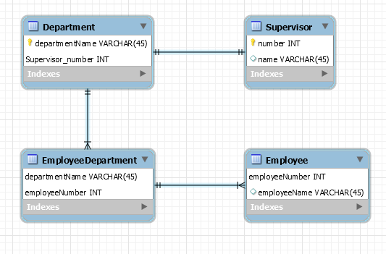
Converting to Physical Diagram

